Slide 1
Chapter 14a
Normalization
Pearson Education © 2009

Slide 2
The Process of Normalization
Formal technique for analyzing a relation based on its primary key and functional dependencies between its attributes.
Often executed as a series of steps. Each step corresponds to a specific normal form, which has known properties.
As normalization proceeds, relations become progressively more restricted (stronger) in format and also less vulnerable to update anomalies.

Slide 3
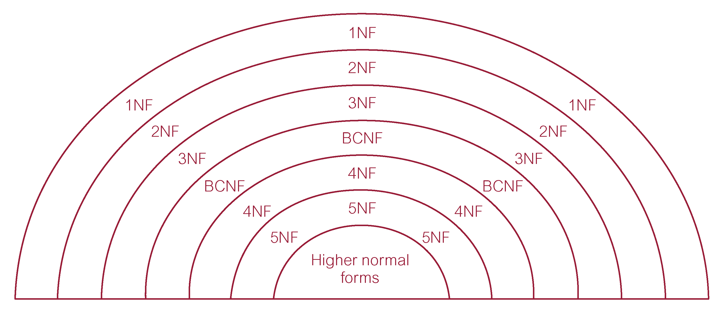
Relationship Between Normal Forms

Slide 4
Unnormalized Form (UNF)
A table that contains one or more repeating groups.
To create an unnormalized table:
  transform data from information source (e.g. form) into table format with columns and rows.

Slide 5
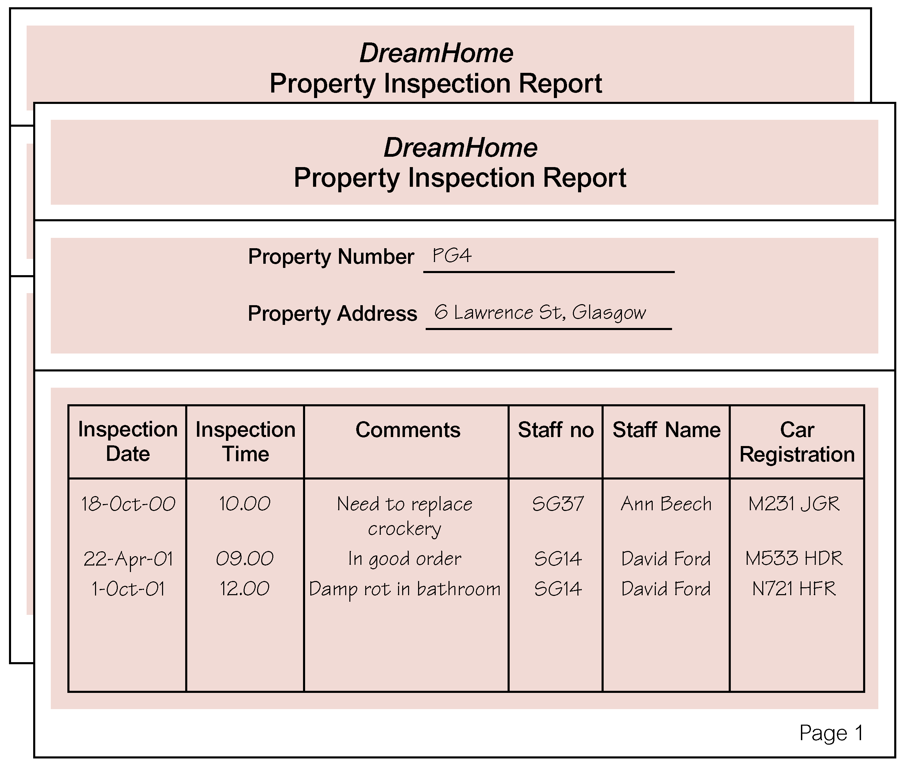
Review of Normalization (UNF to BCNF)

Slide 6
First Normal Form (1NF)
A relation in which intersection of each row and column contains one and only one value.

Slide 7
UNF to 1NF
Nominate an attribute or group of attributes to act as the key for the unnormalized table.
Identify repeating group(s) in unnormalized table which repeats for the key attribute(s).

Slide 8
UNF to 1NF
Remove repeating group by:
  entering appropriate data into the empty columns of rows containing repeating data (‘flattening’ the table).
Or by
  placing repeating data along with copy of the original key attribute(s) into a separate relation.

Slide 9
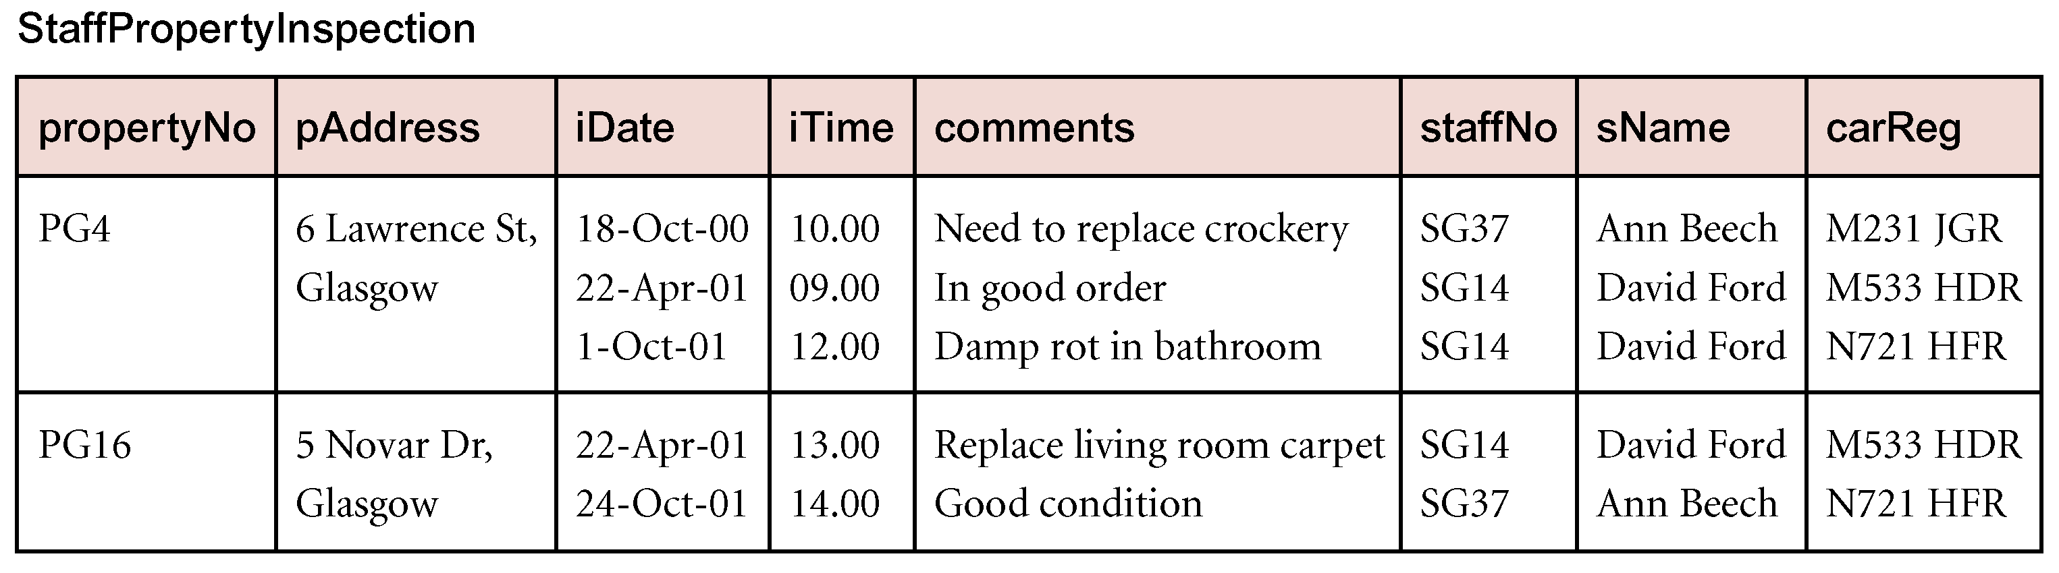
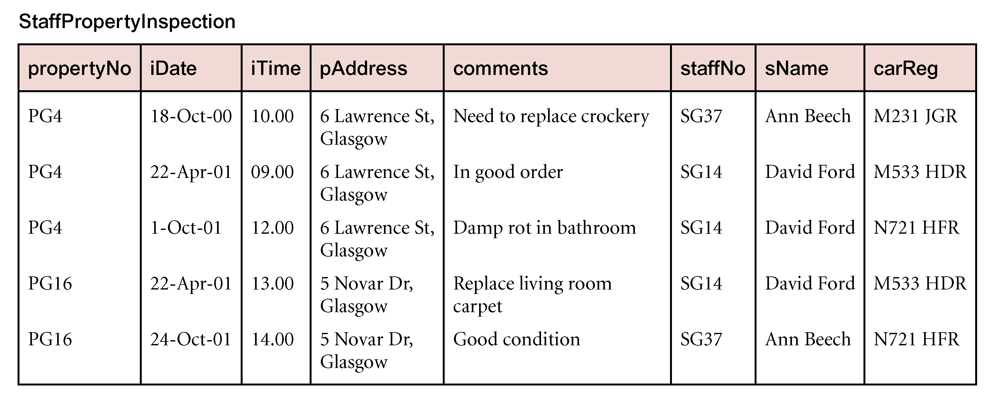
Review of Normalization (UNF to BCNF)

Slide 10
Second Normal Form (2NF)
Based on concept of full functional dependency:
  A and B are attributes of a relation,
  B is fully dependent on A if B is functionally dependent on A but not on any proper subset of A.
2NF - A relation that is in 1NF and every non-primary-key attribute is fully functionally dependent on the primary key.

Slide 11
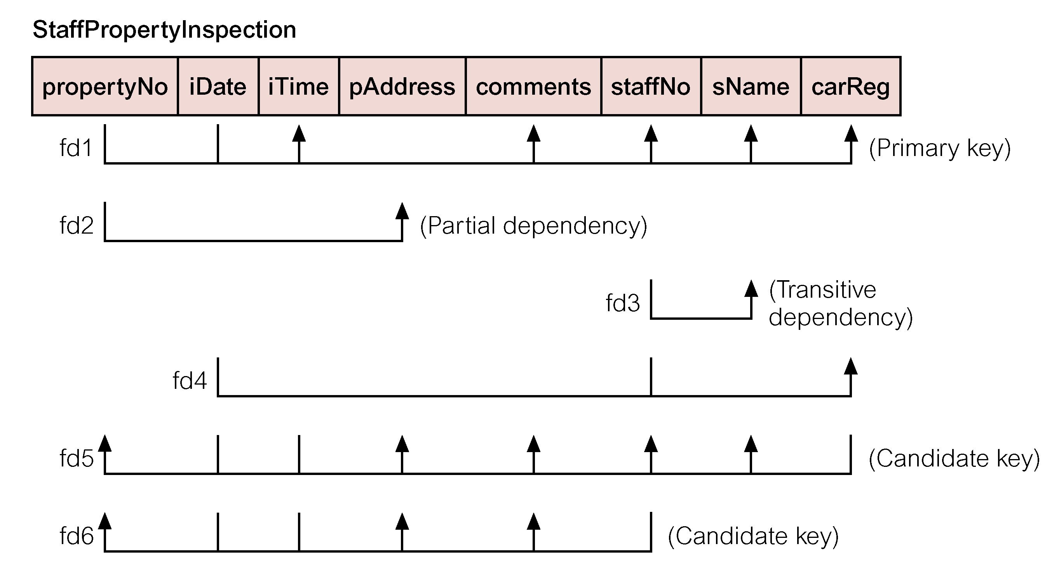
Review of Normalization (UNF to BCNF)
Pearson Education © 2009

Slide 12
1NF to 2NF
Identify primary key for the 1NF relation.
Identify functional dependencies in the relation.
If partial dependencies exist on the primary key remove them by placing them in a new relation along with copy of their determinant.

Slide 13
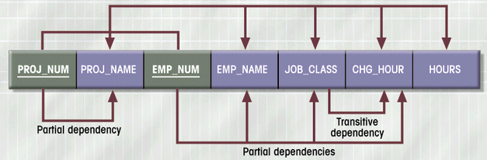
Dependency Diagram (1NF)

Slide 14
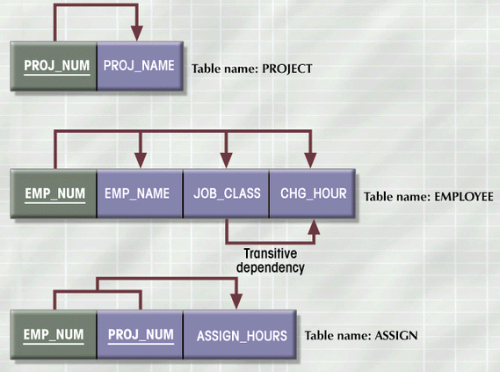
2NF Conversion Results
Figure 4.5

Slide 15
Third Normal Form (3NF)
Based on concept of transitive dependency:
  A, B and C are attributes of a relation such that if A  B and B  C,
  then C is transitively dependent on A through B. (Provided that A is not functionally dependent on B or C).
3NF - A relation that is in 1NF and 2NF and in which no non-primary-key attribute is transitively dependent on the primary key.

Slide 16
2NF to 3NF
Identify the primary key in the 2NF relation.
Identify functional dependencies in the relation.
If transitive dependencies exist on the primary key remove them by placing them in a new relation along with copy of their determinant.

Slide 17
3NF Conversion Results
Prevent referential integrity violation by adding a JOB_CODE
PROJECT (PROJ_NUM, PROJ_NAME)
ASSIGN (PROJ_NUM, EMP_NUM, HOURS)
EMPLOYEE (EMP_NUM, EMP_NAME, JOB_CLASS)
JOB (JOB_CODE, JOB_DESCRIPTION, CHG_HOUR)

Slide 18
General Definitions of 2NF and 3NF
Second normal form (2NF)
  A relation that is in 1NF and every non-primary-key attribute is fully functionally dependent on any candidate key.
Third normal form (3NF)
  A relation that is in 1NF and 2NF and in which no non-primary-key attribute is transitively dependent on any candidate key.

Slide 19
Boyce–Codd Normal Form (BCNF)
Based on functional dependencies that take into account all candidate keys in a relation, however BCNF also has additional constraints compared with general definition of 3NF.
BCNF - A relation is in BCNF if and only if every determinant is a candidate key.

Slide 20
Boyce–Codd normal form (BCNF)
Difference between 3NF and BCNF is that for a functional dependency A → B, 3NF allows this dependency in a relation if B is a primary-key attribute and A is not a candidate key.
Whereas, BCNF insists that for this dependency to remain in a relation, A must be a candidate key.
Every relation in BCNF is also in 3NF. However, relation in 3NF may not be in BCNF.

Slide 21
Boyce–Codd normal form (BCNF)
Violation of BCNF is quite rare.
Potential to violate BCNF may occur in a relation that:
  contains two (or more) composite candidate keys;
  the candidate keys overlap (ie. have at least one attribute in common).

Slide 22
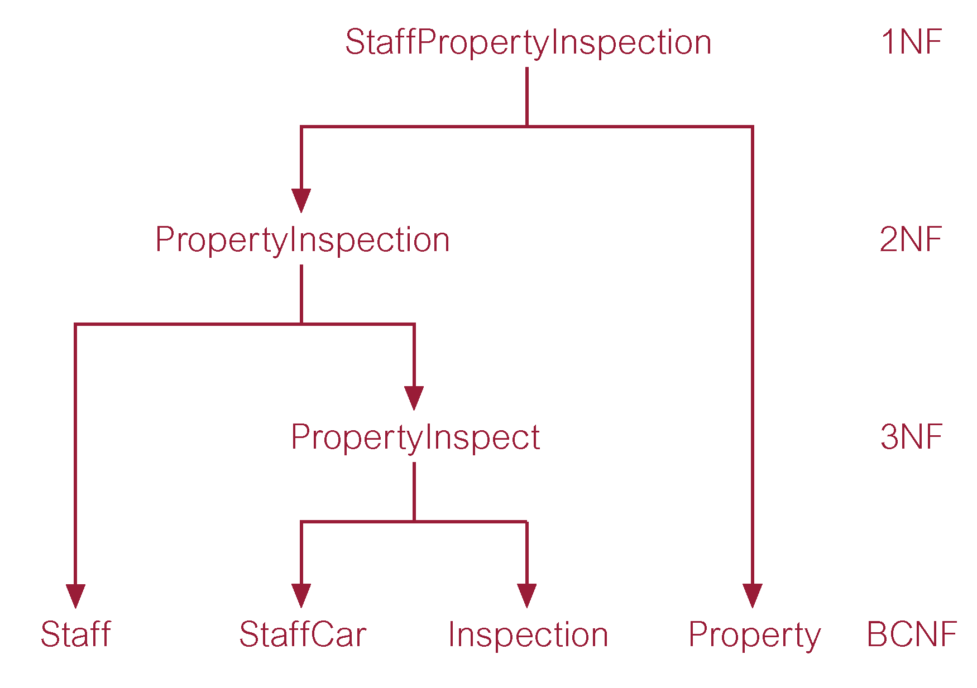
Review of Normalization (UNF to BCNF)

Slide 23
Review of Normalization (UNF to BCNF)

Slide 24
Denormalization
Normalization is one of many database design goals
Normalized table requirements
  Additional processing
  Loss of system speed
Normalization purity is difficult to sustain due to conflict in:
  Design efficiency
  Information requirements
  Processing

Slide 25
Unnormalized Table Defects
Data updates less efficient
Indexing more cumbersome
No simple strategies for creating views

